Slide 1
Introduction to Machine Learning: CS 436/580L Final Review
Instructor: Arti Ramesh
Binghamton University

Slide 2
Quiz Instructions
Keep your answers brief.
Remember to write your name.
No talking is allowed. Only talking is with the TA or me.
Duration: 20 minutes

Slide 3
What Is Machine Learning?
Traditional Programming
Machine Learning
Automating automation
Getting computers to program themselves
Data
Computer
Output
Program
Data
Computer
Program
Output

Slide 4
What did we cover
Supervised Learning
Given data with desired inputs and desired outputs
Learn a function that maps inputs to outputs
Generative vs. Discriminative models
Parametric vs. non-parametric models
Gradient Descent
Point Estimation
Unsupervised Learning
Evaluation metrics (cross validation)

Slide 5
Supervised Learning
Parametric techniques
Decision trees
Naïve Bayes
Linear Classifiers
Logistic Regression, Perceptrons, linear SVM
Non-Linear Classifiers
Kernel trick, support vector machine, Neural networks
Non-parametric techniques
K-nearest neighbors
KD trees

Slide 6
Key Issues
Hypothesis space
When will a particular learning algorithm work and when will it not?
What kind of functions can it approximate
Overfitting and how to avoid it
Regularization and Occam’s razor
Missing data
Handling Continuous attributes

Slide 7
Miscellaneous
Learning as optimization
Gradient descent (compute gradients)
Maximum Likelihood estimation
Definition of likelihood
Bayesian approaches
MAP estimation
Generative vs Discriminative Learning
Online vs Batch Learning
Distance functions (k-nearest neighbors and LWR)

Slide 8
Evaluation
All points within the ellipse are positive and all points outside the ellipse are negative
Test-set vs validation-set vs training-set
Cross Validation
Leave one out
K-fold
Accuracy (tp+tn)/(tp+fp+tn+fn)
Precision vs Recall
Precision: tp/ (tp+fp)
Recall: tp/(tp+fn)
F-measure
2 precision*recall / (precision+recall)
fp
tp
fn
tn
Learned function
Actual function

Slide 9
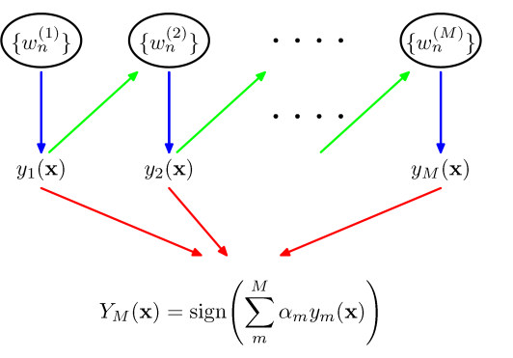
Bias/Variance, Boosting and Bagging
Boosting
Sequential approach
Reduces bias
Works with stable methods too
Performance suffers in presence of noise
Bagging
Bootstrapping approach
Reduces variance by averaging
Has little effect on bias
Does not work with stable methods
Does not hurt performance on noisy datasets

Slide 10
Computational Learning Theory
PAC learning
Sample complexity: Just need to determine the size of a hypothesis space to instantiate this result for learning specific classes of concepts
For consistent learners
For agnostic learners

Slide 11
VC-dimension
Shattering: A hypothesis space is said to shatter a set of instances iff for every partition of the instances into positive and negative, there is a hypothesis that produces that partition
The Vapnik-Chervonenkis dimension, VC(H). of hypothesis space H defined over instance space X is the size of the largest finite subset of X shattered by H. If arbitrarily large finite subsets of X can be shattered then VC(H) = ∞
If there exists at least one subset of X of size d that can be shattered then VC(H) ≥ d. If no subset of size d can be shattered, then VC(H) < d.
For a single intervals on the real line, all sets of 2 instances can be shattered, but no set of 3 instances can, so VC(H) = 2.
Since |H| ≥ 2^{m}, to shatter m instances, VC(H) ≤ log₂|H|
Sample complexity using VC(H) instead of |H|

Slide 12
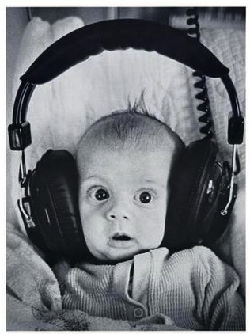
Clustering
Clustering systems:
Unsupervised learning
Requires data, but no labels
Detect patterns eg in
Group emails or search results
Customer shopping patterns
Program executions (intrusion detection)
Useful when don’t know what you’re looking for
But: often get gibberish

Slide 13
K-means and Agglomerative clustering
Flat vs Hierarchical clustering
Algorithm descriptions
Will the algorithm converge and why?
To a global optimum?
Will it always find the true patterns in the data?
If the patterns are very very clear?
Runtime?

Slide 14
EM algorithm: Pictorial View
Given a set of Parameters and training data
Estimate the class of each training example using the parameters yielding new (weighted) training data
Relearn the parameters based on the new training data
Class assignment is probabilistic or weighted (soft EM)
Class assignment is hard (hard EM)
Supervised learning problem

Slide 15
What you should know
EM for mixture of Gaussians:
Also coordinate ascent (why it works)
How to “learn” maximum likelihood parameters (locally max. like.) in the case of unlabeled data
Relation to K-means
Hard / soft clustering
Probabilistic model
Remember, E.M. can get stuck in local minima,
And empirically it DOES

Slide 16
Bayesian networks
Two equivalent views
Compact Representation of a probability distribution
Compact Representation of a set of conditional independence assumptions
Inference problems
Inference by enumeration

Slide 17
PrACTICAL ADVICE: How to use machine learning for solving real world problems!

Slide 18
Steps in Supervised Learning
Determine the representation for “x,f(x)” and determine what “x” to use
Feature Engineering
Gather a training set (not all data is kosher)
Data Cleaning
Select a suitable evaluation method
Find a suitable learning algorithm among a plethora of available choices
Notes:
Given a real-world “Big data application”, how do you perform supervised learning. The key steps are: (1)

Slide 19
Feature Engineering is the Key
Most effort in ML projects is constructing features
Black art: Intuition, creativity required
Understand properties of the task at hand
How the features interact with or limit the algorithm you are using.
ML is an iterative process
Try different types of features, experiment with each and then decide which feature set/algorithm combination to use
Notes:
At the end of the day, some machine learning projects succeed and some fail. What makes the difference? Easily the most important factor is the features used.

Slide 20
What features will you use?
Examples
Spam Filtering
Mapping images to names
Feature Combination
Linear models cannot handle some dependencies between features (e.g. XOR)
Feature combinations might work better.
Quick growth of the number of features.

Slide 21
Evaluation
Accuracy
Fraction of the examples that are correctly classified by the learner
Precision, Recall and F-score (Next slide)
Squared error (Regression problems)
Likelihood
Posterior probability
Cost / Utility
Etc.

Slide 22
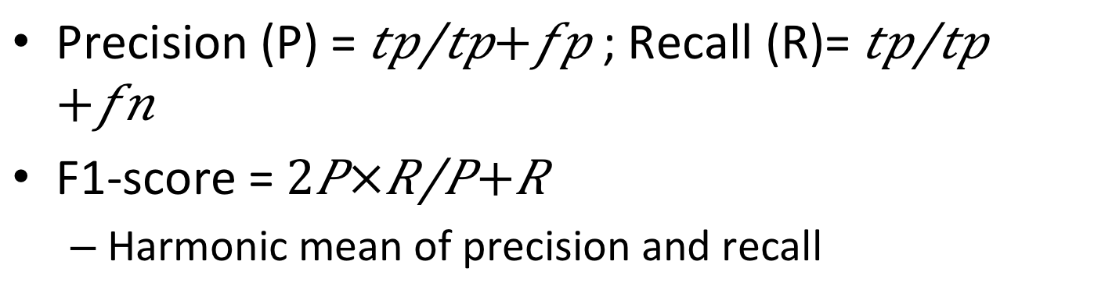
Precision, Recall and F-1 score
 | Actual=True | Actual=False
Predicted=True | tp (correct result) | fp (unexpected result)
Predicted=False | fn (missing result) | tn (correct absence of result)
Precision (P) = $\frac{tp}{tp+fp}$; Recall (R)= $\frac{tp}{tp+fn}$
F1-score = $2\frac{P×R}{P+R}$
Harmonic mean of precision and recall
Notes:
P = number of correct results divided by all returned results
R = number of correct results divided by the number of results that should have been returned.

Slide 23
What algorithms (Classifiers/learners) to use
Naïve Bayes
Logistic Regression
Linear SVMs
Decision Trees
Neural Networks
Support Vector Machines
K-nearest neighbors (Non-parametric)
Bagging (Meta); Boosting (Meta)
Linear classifiers
Non-linear
Weka Software

Slide 24
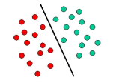
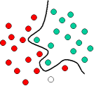
Classifiers: Bias versus Variance
High Bias, low variance
Low Bias, High variance
Linear Classifier
Naïve Bayes
Logistic Regression
Perceptron
Non-Linear Classifier
Support vector machine (Kernels)
Neural networks
Decision Trees
Simpler
Complex
Notes:
Bias is a learner’s tendency to consistently learn the same wrong thing. Variance is the tendency to learn random things irrespective of the real signal.

Slide 25
Learning = Representation + Evaluation + Optimization
Thousands of learning algorithms
Combinations of just three elements
Representation | Evaluation | Optimization
Instances | Accuracy | Greedy search
Hyperplanes | Precision/Recall | Branch & bound
Decision trees | Squared error | Gradient descent
Sets of rules | Likelihood | Quasi-Newton
Neural networks | Posterior prob. | Linear progr.
Graphical models | Margin | Quadratic progr.
Etc. | Etc. | Etc.

Slide 26
It’s Generalization that Counts
Divide data into training, test and hold-out or validation set
Algorithm must work on test examples never seen before
Training examples can just be memorized
Don’t tune parameters on test data
Use cross-validation
Training
Data
Hold-Out
Data
Test
Data

Slide 27
K-Fold Cross Validation
Choose a suitable K (usually 10)
Test
Train on (k
-
1) splits
k-fold

Slide 28
Data Alone Is Not Enough
Classes of unseen examples are arbitrary
So learner must make assumptions
“No free lunch” theorems
Luckily, real world is not random
Induction is knowledge lever

Slide 29
Overfitting Has Many Faces
Classifier A is better than B on the training set but the reverse is true on the test set!!
The biggest problem in machine learning
Bias and variance (Simple vs. Complex)
Can learn a simpler linear function vs. can learn any function
Less powerful learners can be better
Solutions: Cross-validation; Regularization
Notes:
Basically, what it means is that knowledge and data we have are not sufficient to completely determine the correct classifier and we run the risk of just hallucinating a classifier (or parts of it) that is not grounded in reality, and is simply encoding random quirks in the data.
Bias is a learner’s tendency to consistently learn the same wrong thing. Variance is the tendency to learn random things irrespective of the real signal.
The most popular one is adding a regularization term to the evaluation function. This can, for example, penalize classifiers with more structure, thereby favoring smaller ones with less room to overfit. Another option is to perform a statistical significance test like chi-square before adding new structure, to decide whether the distribution of the class really is different with and without this structure. These techniques are particularly useful when data is very scarce. Nevertheless, you should be skeptical of claims that a particular technique “solves” the overfitting problem. It’s easy to avoid overfitting (variance) by falling into the opposite error of underfitting (bias). Simultaneously avoiding both requires learning a perfect classifier, and short of knowing it in advance there is no single technique that will always do best (no free lunch).

Slide 30
Intuition Fails In High Dimensions
Curse of dimensionality
Sparseness worsens exponentially with number of features
Irrelevant features ruin similarity
In high dimensions all examples look alike
3D intuitions do not apply in high dimensions
Blessing of non-uniformity
Notes:
Generalizing correctly becomes exponentially harder as the dimensionality (number of features) of the examples grows, because a fixed-size training set covers a dwindling fraction of the input space.
Even with a moderate dimension of 100 and a huge training set of a trillion examples, the latter covers only a fraction of about 10⁻¹⁸ of the input space. This is what makes machine learning both necessary and hard.

Slide 31
Theoretical Guarantees Are Not What They Seem
Bounds on number of examples needed to ensure good generalization
Extremely loose
Low training error ≠> Low test error
Asymptotic guarantees may be misleading
Theory is useful for algorithm design, not evaluation

Slide 32
More Data Beats a Cleverer Algorithm
Easiest way to improve: More data
Then
Data is bottleneck
Now:
Scalability is bottleneck
ML algorithms more similar than they appear
Clever algorithms require more effort but can pay off in the end
Biggest bottleneck is human time

Slide 33
Learn Many Models, Not Just One
Three stages of machine learning
Try variations of one algorithm, chose one
Try variations of many algorithms, choose one
Combine many algorithms, variations
Ensemble techniques
Bagging
Boosting
Stacking
Etc.

Slide 34
Simplicity Does Not Imply Accuracy
Occam’s razor
Common misconception: Simpler classifiers are more accurate
Contradicts “no free lunch” theorems
Counterexamples: ensembles, SVMs, etc.
Can make preferred hypotheses shorter

Slide 35
Representable Does Not Imply Learnable
Standard claim: “My language can represent/approximate any function”
No excuse for ignoring others
Causes of non-learnability
Not enough data
Not enough components
Not enough search
Some representations exponentially more compact than others

Slide 36
Advanced topics

Slide 37
Supervised Learning and its Generalizations
Supervised Learning
Desired output is simple. (e.g., purchase an item or not; the person has the disease or not; etc.)
Structured Prediction: is a Generalization
Desired output is complex.

Slide 38
Structured Prediction: Examples
Parsing: given an input sequence, build a tree whose leaves are the elements in the sequence and whose structure obeys some grammar.
Collective classification: given a graph defined by a set of vertices and edges, produce a labeling of the vertices.
Labeling web pages given link information

Slide 39
Models and Algorithms for Structured Prediction
Probabilistic Graphical Models
Compact representation of joint distribution
Principled way of dealing with uncertainty
Take advantage of conditional independence
Markov logic and statistical relational models
Model both relational structure and uncertainty
One example related with another example
Considerable machine learning expertise required here! (not yet a blackbox)

